Slide 1

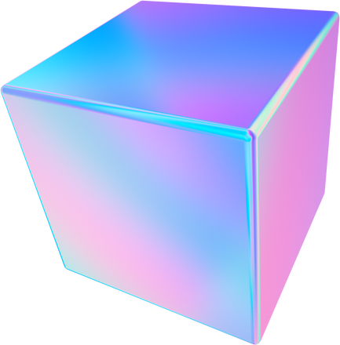


INTEGRATED CURCUITS
CLA ADDER
www.reallygreatsite.com

Slide 2
Implementation of a Carry Look Ahead Adder optimized for speed and energy. high performance, power and area efficient using 22nm process in electric tool.

Slide 3
Paper Referencing
Full Static
Full Dynamic
combination

Slide 4
LOGIC AND SCHEMATICS DETAILS

Slide 5
Two main parts:
Static Part (sum block):
using four full adders blocks
- each full adder built from two XOR blocks and a NAND block
Dynamic Part (Carry block)

Slide 6
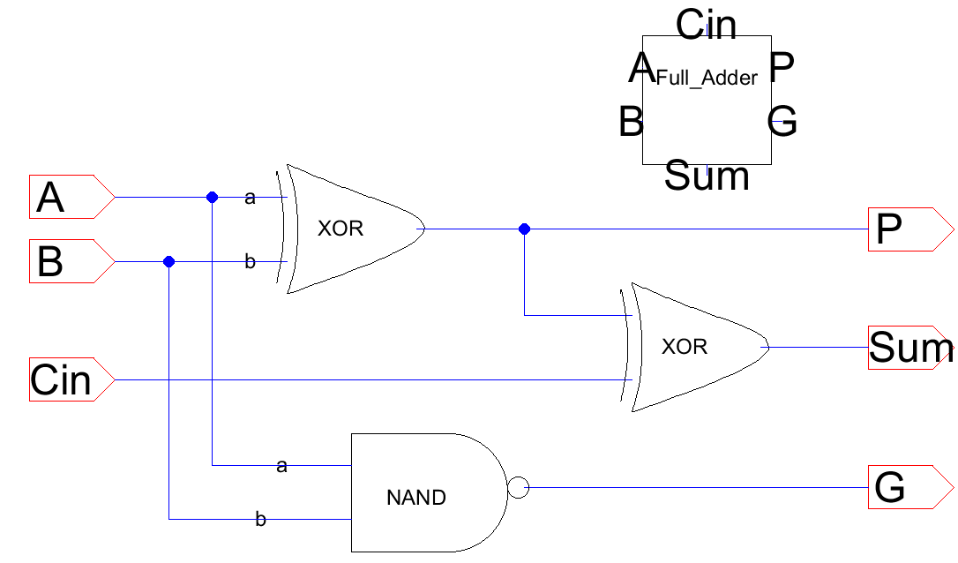
Full adder schematic:
it produces a Propagate (P) and a Generate (G) signals which are the core of CLA adder logic

Slide 7
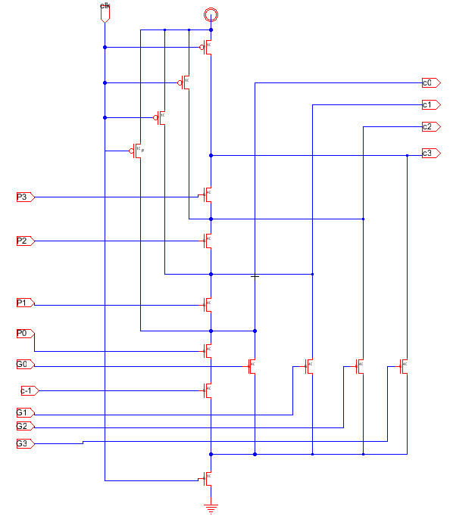
Carry block schematic:
it takes the Propagate (P) and Generate (G) signals from the previous adders block so it can produce the carry signals in parallel, resulting in an adder with much higher speed

Slide 8
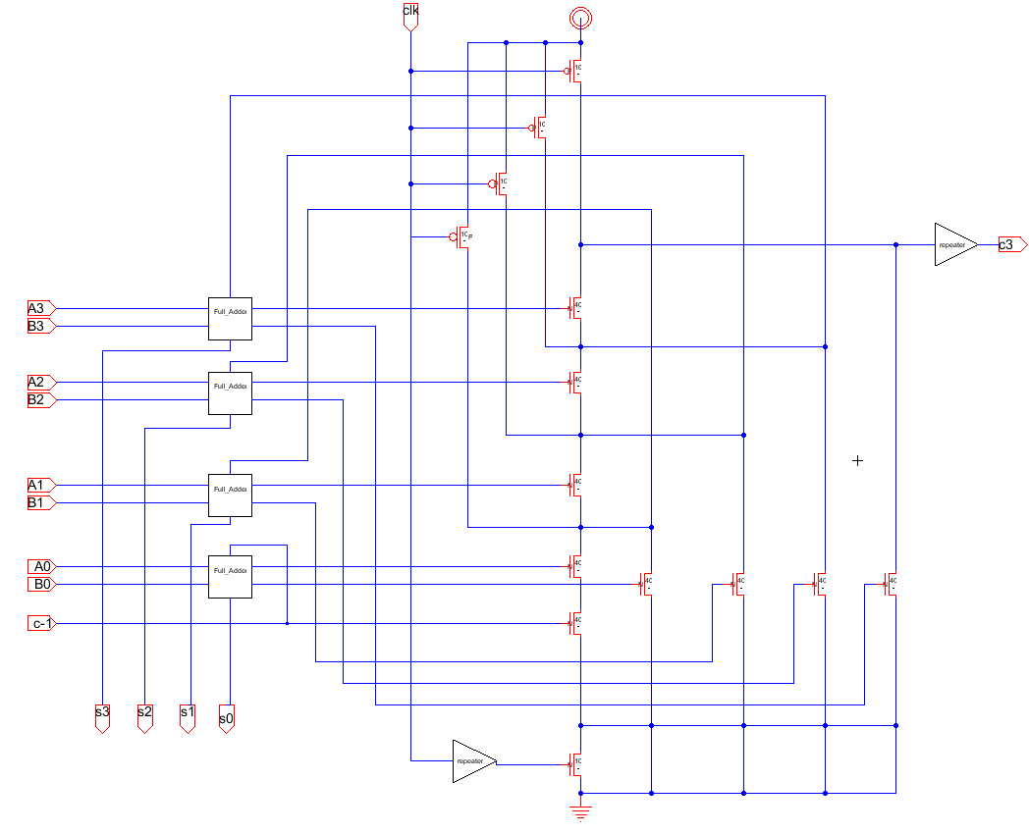
CLA adder full schematic

Slide 9
LAYOUT

Slide 10
Layout design:
-Wiring
Higher metals are used in the layout for long wires, in general higher metals have less resistivity, making them suitable.
enough separations between adjacent same metal layers to avoid cross capacitance.
for better area utilization, odd # metals vertical, even # metal Horizontal.

Slide 11
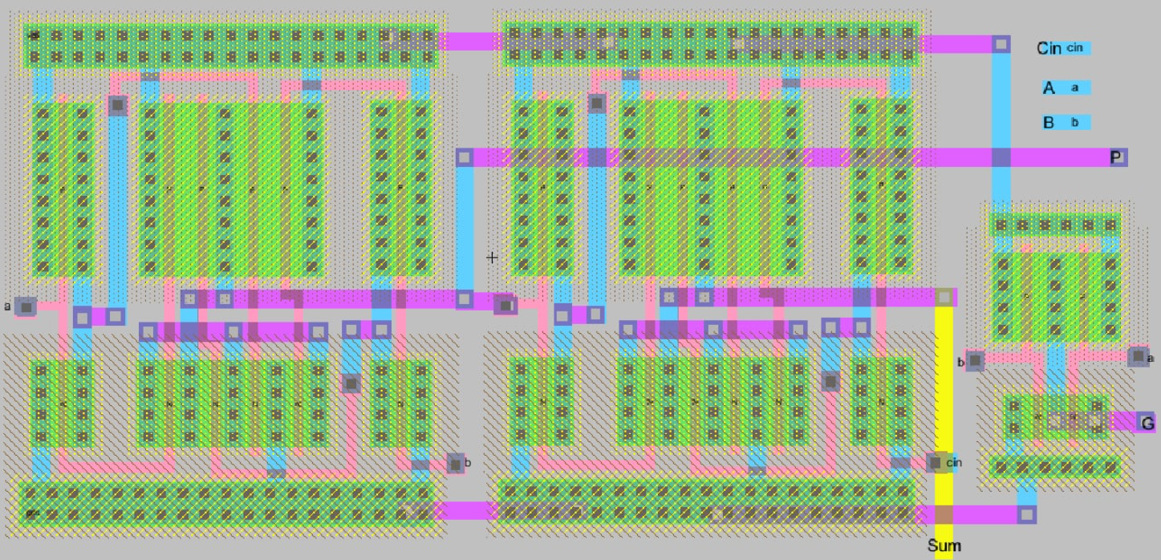
1x1 Full Adder layout:

Slide 12
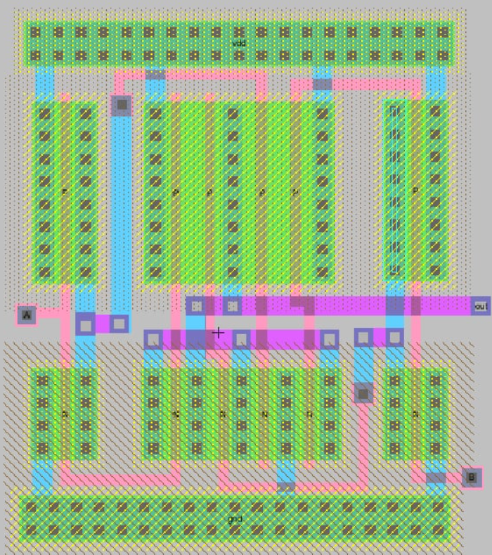
XOR gate layout:

Slide 13
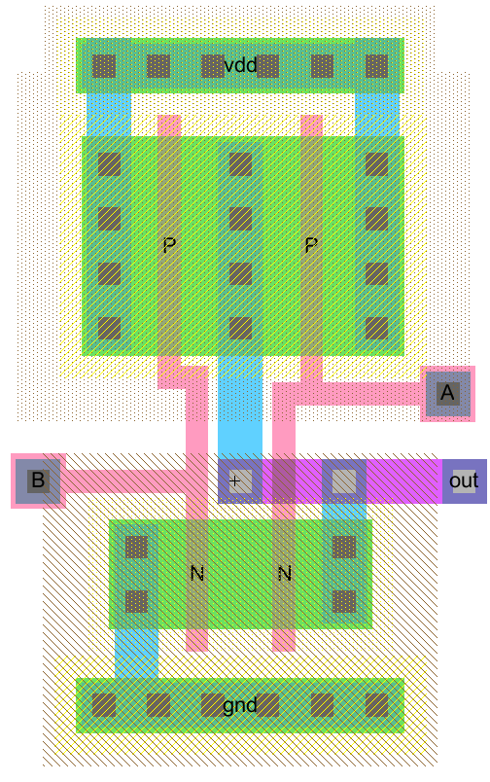
NAND gate layout:

Slide 14
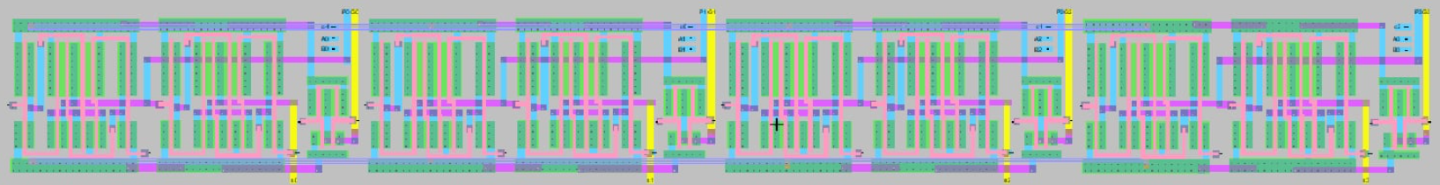
4x4 Full Adder layout:

Slide 15
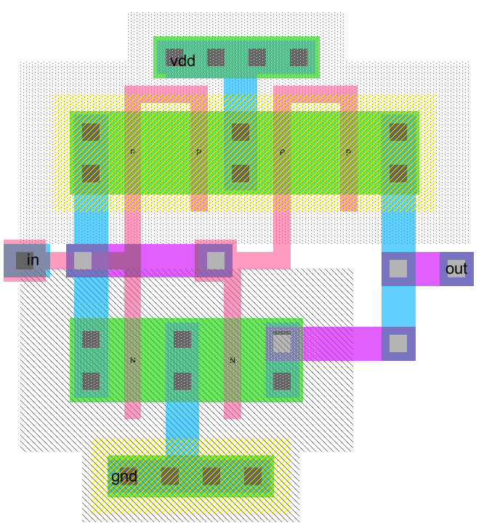
Repeater layout:

Slide 16
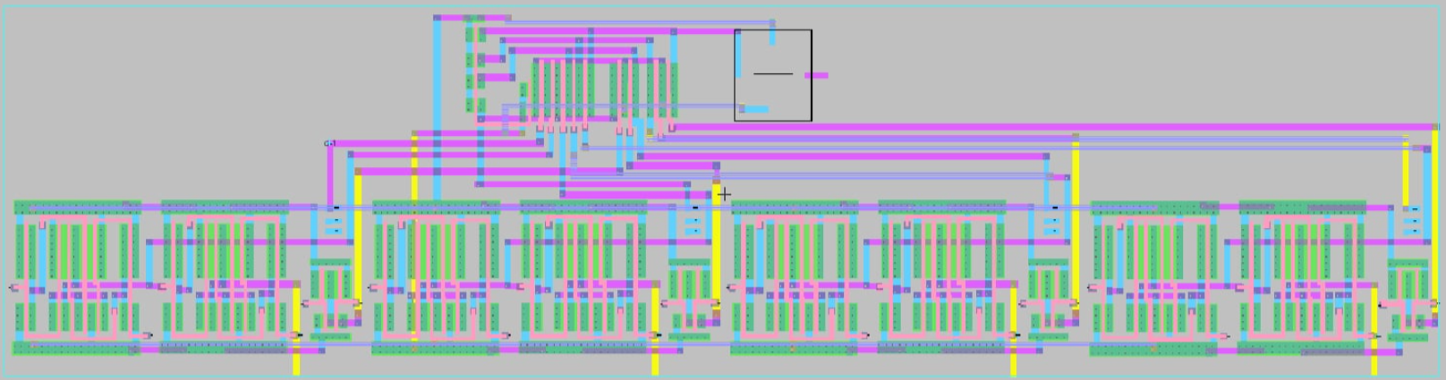
Full Layout

Slide 17
Optimizations

Slide 18
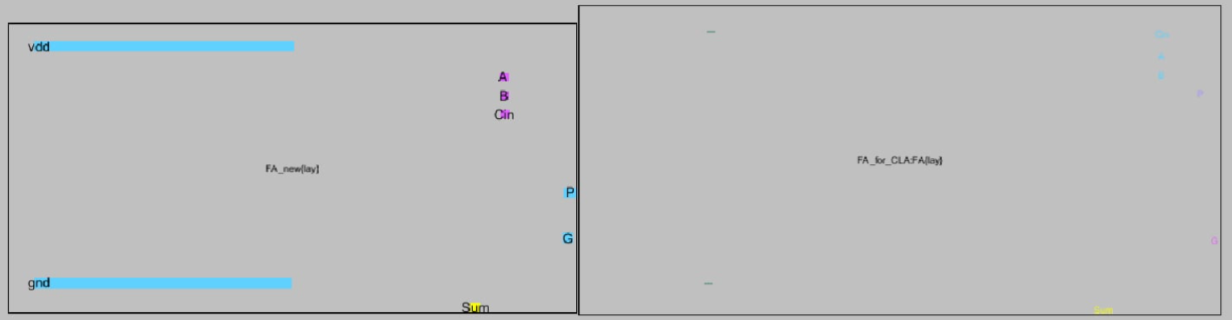
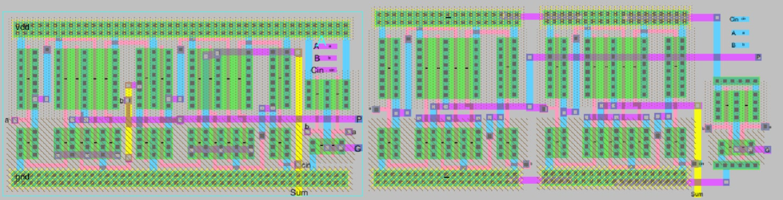
Full adders

Slide 19
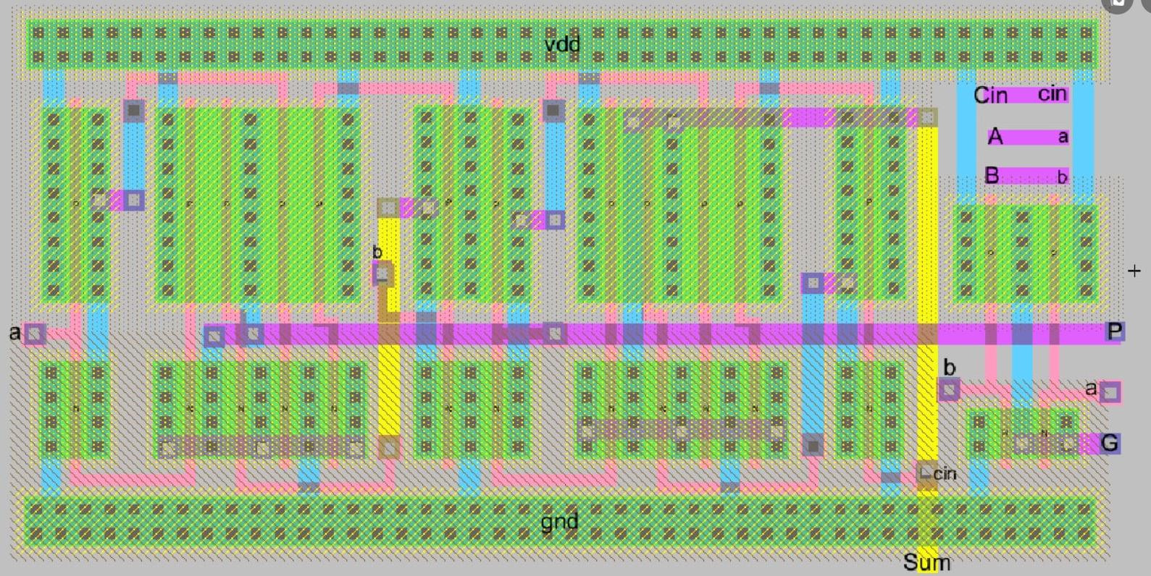
Optimizad adder Layout

Slide 20
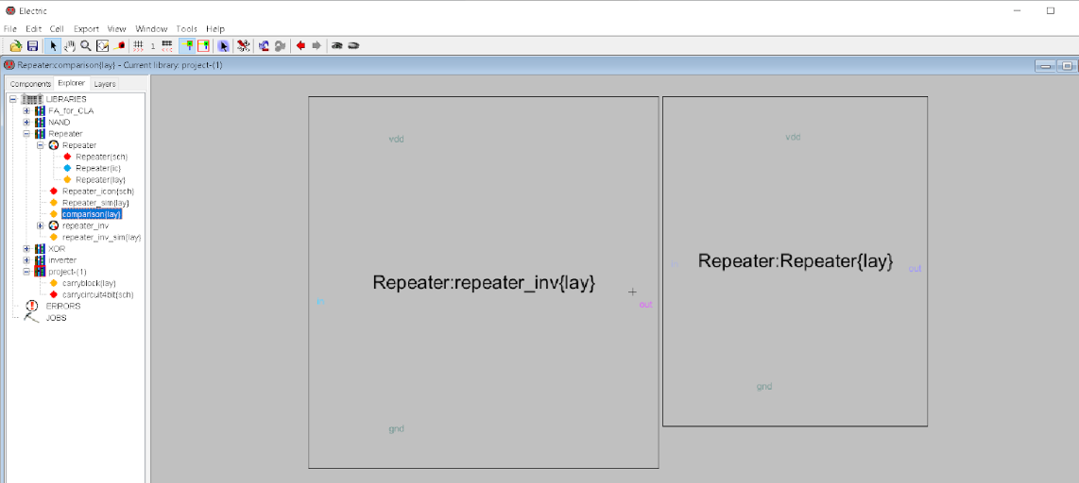
Layout Optimizations:
-in the repeater’s layout for example, PMOS gates were flipped, resulting in:
reduction in diffusion capacitance
minimization in area by sharing power contacts

Slide 21
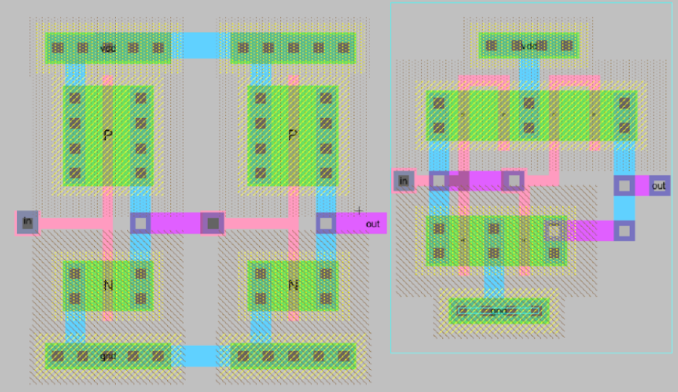
Layout Optimizations:
repeater’s layout before and after minimization:

Slide 22
Optimization of the Complete Layout

Slide 23
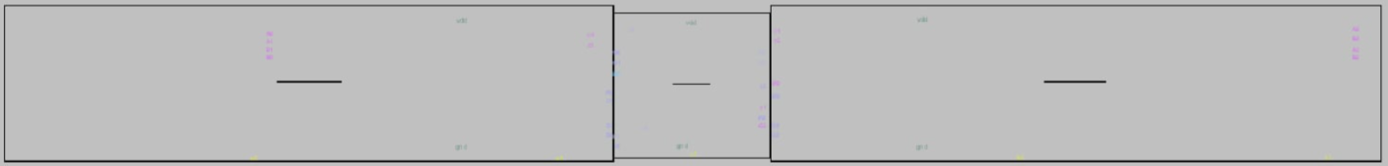
Flour planning of Full Final Layout

Slide 24
Blocks Details

Slide 25
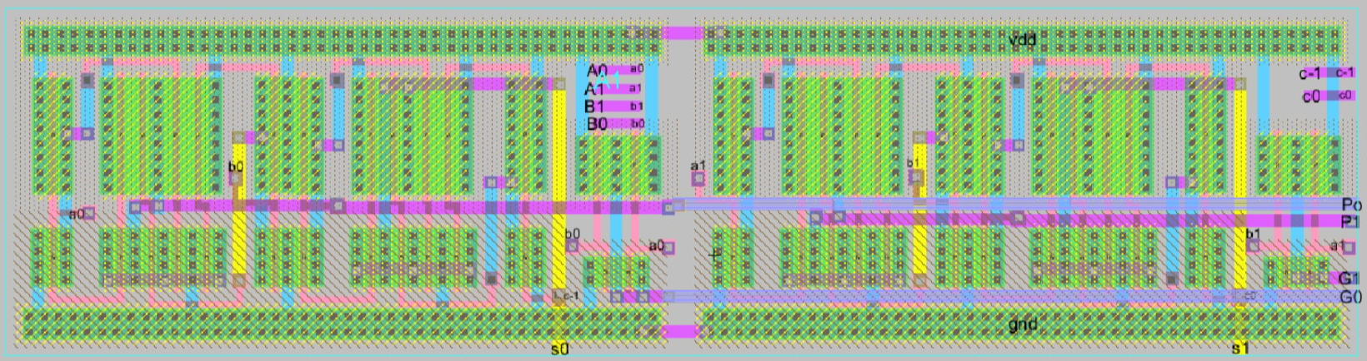
2x2bit Full adders (left side)

Slide 26
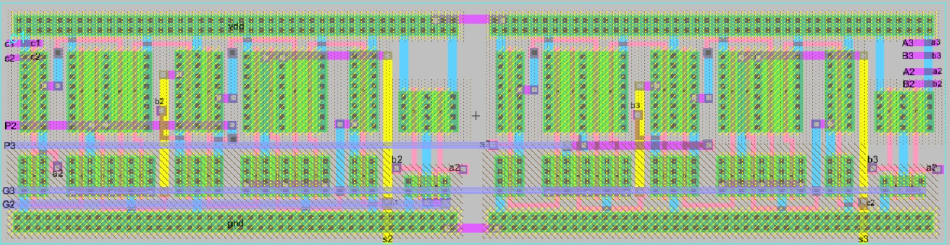
2x2bit Full adders (right side)

Slide 27
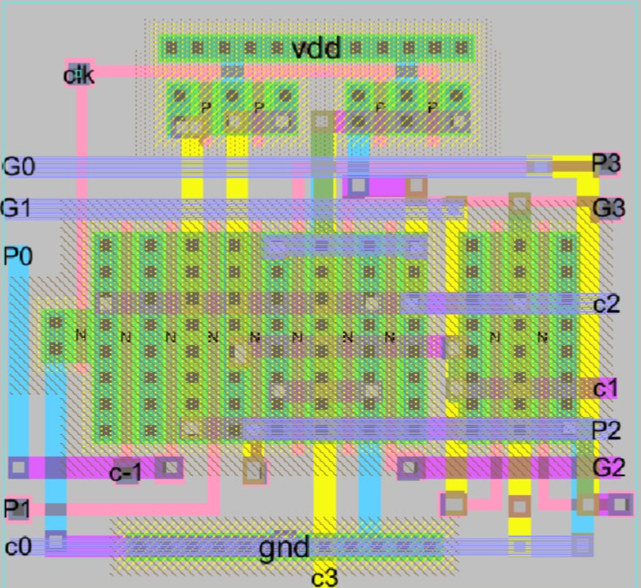
Carry generator block

Slide 28
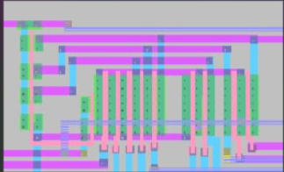
Carry generator block (before and after):

Slide 29
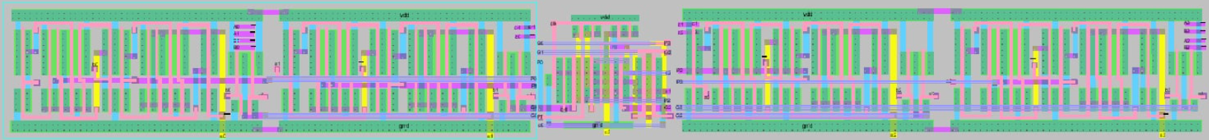
before optimization:
CLA adder full layout:
after optimization:
after optimization:
-area: 143 pm^2
-area: 61 pm^2

Slide 30
MODULAR DESIGN FOR FUTURE BIT EXTENSION

Slide 31
SIMULATION AND CODE

Slide 32
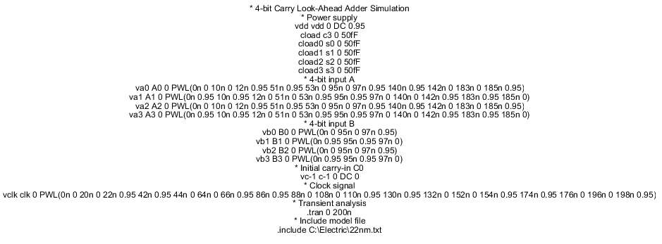
CODE

Slide 33
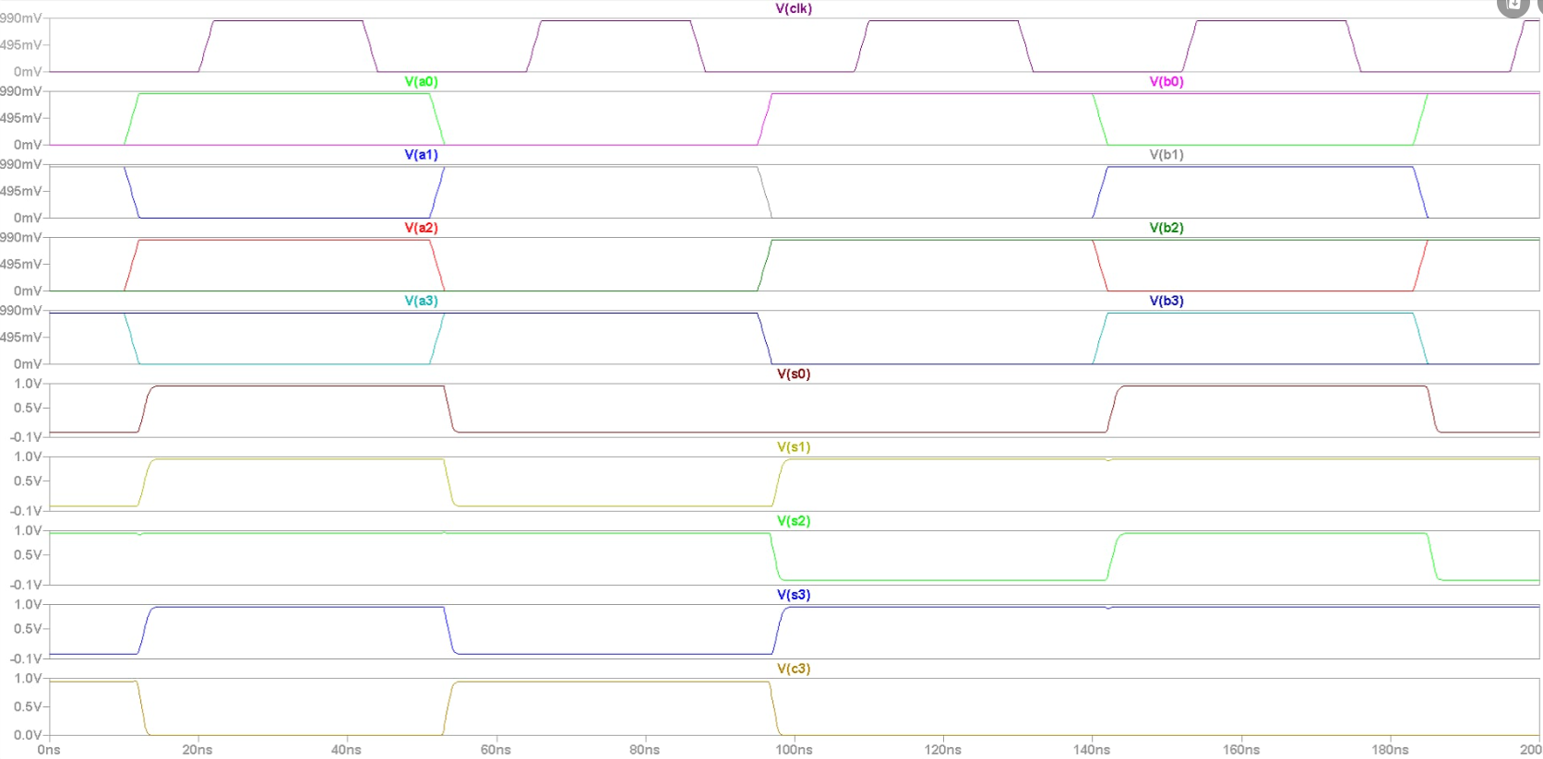
SIMULATION OF SCHEMATIC

Slide 34
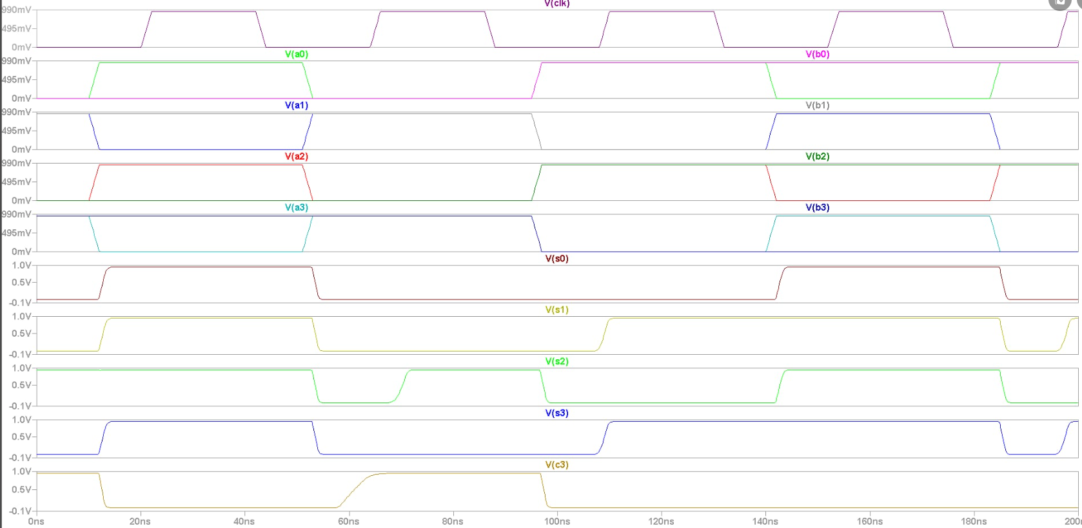
SIMULATION OF LAYOUT

Slide 35
Performance Parameters:
Schematics:
delay: 2 ns
fall time: 1.639 ns
rise time: 2ns
power:
41.8 uA * 0.95v = 39.71 uW
Layout:
delay: 10 ns
avg fall time: 1.9 ns
avg rise time: 5.37 ns ( 4.33- 2.18- 9.6 )
power:
43.36 uA * 0.95 v = 41.16 uW

Slide 36
Thank You !

